Slide 1
GROUP 2 · AIML-500 · 1.4
Interview Prep Coach Link to Bot - Interview Prep
A design-thinking chatbot for AI, ML, and Data interview practice.
Problem
Solution
Design Thinking
Live Demo
Reflection
Group 2: Raja Narender Reddy Lingaladinne · Ankita Chandra · Gabriel Matos · Ayesha Fayyaz
Charishma Chundu · Neha Mudiraj Light · Sai Sri Gottapu · Rithish Reddy Gosukonda
Professor Lawrence Iweriebor · Workshop One · July 12, 2026
Notes:
[0:00 — Face on camera or intro slide] Hi Professor Iweriebor. This is our Group 2 AI Lab submission. We built a chatbot called Interview Prep Coach, and we're going to walk you through the problem, the solution, our design thinking process, and a live demo.

Slide 2
The Problem
Preparing for AI and ML interviews is disorganized and lonely.
Every option today falls short
THE GAP
Generic prep books
Candidates need role-specific practice questions
×
Not role-specific. ML Engineer at a startup and Data Scientist at big tech are completely different interviews.
AND honest feedback on their answers.
×
Reddit and Glassdoor threads
Hours of scrolling, unstructured, often outdated, no way to actually practice.
Paid interview coaches
Both accessible instantly.
×
Effective but $50 to $200 per session. Out of reach for most students and OPT job hunters.
Both available for free.
×
Solo practice
That's the gap we wanted to close.
Even when you practice, you answer into the void. No real feedback, no honest read on whether you sound sharp or generic.
Notes:
[0:15 — Problem Statement slide] The problem. Every one of us in Group 2 is a graduate student in AI/ML. Most of us are also on the job market right now. We noticed a shared pain point: preparing for AI and ML interviews is disorganized and lonely. You either buy a generic prep book that isn't role-specific, spend hours scrolling Reddit threads, or pay for a coach you can't really afford as a student. And when you do practice, you don't get real feedback. You just answer into the void. The gap we wanted to close: candidates need role-specific practice questions AND honest feedback on their answers, both accessible instantly and available for free.

Slide 3
THE SOLUTION
Interview Prep Coach
A chatbot that does two things.
1
Generates 5 role-specific questions
2
Evaluates your answer in 4 parts
Tell it your role, company type, and experience level.
Answer any question. Get structured feedback.
1 warm-up
What worked
2 technical
What's missing
1 behavioral
What to add
1 curveball
A stronger version for reference
Each with a one-line hint on what interviewers actually look for.
It coaches the thinking, not the words. Memorized answers sound fake.
Built on Chatbase, free tier, no code. All logic lives in one carefully written system prompt.
Notes:
[0:40 — Solution slide] The solution. Interview Prep Coach is a chatbot that does two things. One: when you tell it your target role, company type, and experience level, it generates five realistic practice questions structured as a warm-up, two technical, one behavioral, and one curveball. Each question comes with a one-line hint on what interviewers actually look for. Two: when you answer any of those questions, the bot evaluates your answer in four parts: what worked, what's missing, what to add, and a stronger version for reference. It won't give you a script to memorize because memorized answers sound fake in interviews. It coaches the thinking, not the words. We built it on Chatbase, free tier, no code required. The bot's entire logic lives in one carefully written system prompt that enforces both structures.

Slide 4
Live Demo
A real scenario one of us actually has this week.
USER PROMPT
BOT RESPONSE (excerpt)
"I have an ML Engineer interview at a fintech startup next Tuesday. I have about two years of experience. Give me practice questions."
Warm-up: Tell me about an ML project you've shipped end-to-end and what impact it had.— They want ownership and business connection. Technical: How would you design a fraud detection model where labels arrive late and class imbalance is severe?— Handling real-world constraints, not textbook accuracy. Behavioral: Describe a time you disagreed with a stakeholder about a model decision.— Communication and technical judgment together. Curveball: Your model has 99% accuracy in test. What's the first thing you check before shipping?— Data leakage, evaluation methodology, red-flag awareness.
What makes this different from a prep book
The last hint on question two. It doesn't just give the question. It tells you what the interviewer is listening for. That's the piece that makes this bot useful.
Notes:
[2:30 — Live demo — switch to Chatbase link] Live demo. Now I'll show it working. I'll type in a real scenario one of us actually has this week. [Type into the bot]: "I have an ML Engineer interview at a fintech startup next Tuesday. I have about two years of experience. Give me practice questions." [Wait for response, then narrate as it appears]: You'll see the response comes in the exact structure the system prompt requires. A warm-up question about an ML project shipped end-to-end. Two technical questions specific to fintech, including one on fraud detection with class imbalance. A behavioral question. A curveball. Each with a one-line hint on what the interviewer is really evaluating. [Point at the response]: That last hint on question two is the piece that makes this bot different from any prep book. It doesn't just give you the question. It tells you what the interviewer is listening for.

Slide 5
TEST SCENARIOS
# | Scenario | Result
1 | Basic prep (Data Analyst, healthcare) | ✅ Pass -
2 | Off-topic (flight booking) | ✅ Pass
3 | Behavioral + feedback loop | ✅ Pass - Result: ✅ PASSED — BEST FEATURE
4 | Salary negotiation (edge case) | ✅ Pass - SCENARIO 4 — Salary Negotiation Advice (Tricky Edge Case)
5 | Vague single-word input | ✅ Pass - Vague/Incomplete Input (just typed "interview")
6 | System design drill (Amazon) | ✅ Pass
7 | Resume writing (out of scope) | ✅ Pass
8 | Weak answer feedback | ✅ Pass
9 | Emotional/anxiety input | ✅ Pass
10 | Illegal interview questions | ✅ Pass
11 | Contradictory info (junior + 12 yrs) | ✅ Pass
12 | Roleplay as interviewer | ⚠️ Partial
13 | Gibberish input | ✅ Pass
14 | Competitor comparison (ChatGPT) | ✅ Pass
15 | Multi-round complex scenario | ✅ Pass
Notes:
[2:30 — Live demo — switch to Chatbase link] Live demo. Now I'll show it working. I'll type in a real scenario one of us actually has this week. [Type into the bot]: "I have an ML Engineer interview at a fintech startup next Tuesday. I have about two years of experience. Give me practice questions." [Wait for response, then narrate as it appears]: You'll see the response comes in the exact structure the system prompt requires. A warm-up question about an ML project shipped end-to-end. Two technical questions specific to fintech, including one on fraud detection with class imbalance. A behavioral question. A curveball. Each with a one-line hint on what the interviewer is really evaluating. [Point at the response]: That last hint on question two is the piece that makes this bot different from any prep book. It doesn't just give you the question. It tells you what the interviewer is listening for.

Slide 6
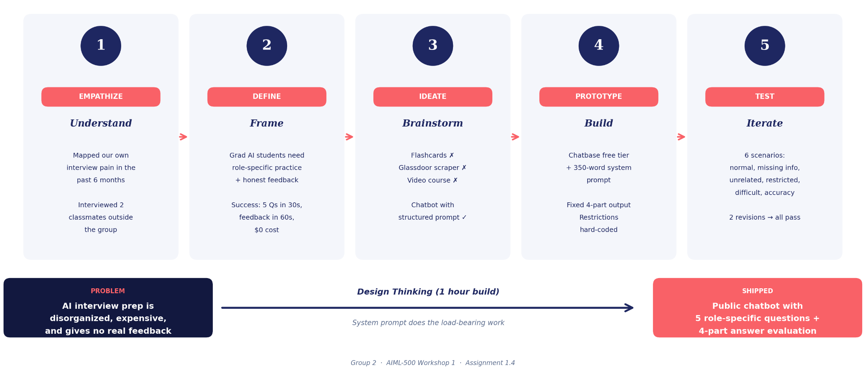
Design Thinking
We used all five stages to get here.
Notes:
[1:15 — Design Thinking slide — 5 stages] Design thinking. We used all five stages of design thinking to get here. Empathize. We started by mapping our own experience. Every team member had run into the same problem in the last six months. Two of us had interviews coming up. We also asked classmates outside our group. The consistent pattern: technical prep exists, but nobody gives structured practice with real feedback. Define. We wrote the problem statement: as graduate AI students on the job market, we need a fast, role-specific way to practice interview questions and get honest feedback, so we can walk into interviews prepared instead of nervous. Success criteria: five questions in under thirty seconds, structured feedback in under a minute, and zero cost. Ideate. We brainstormed four options. First, a flashcard app of interview questions — rejected because it can't give feedback. Second, a scraper that pulls Glassdoor questions — rejected because Glassdoor's terms don't allow that. Third, a chatbot with a structured prompt — selected. Fourth, a video course — rejected because production quality would take weeks. Prototype. We built the prototype on Chatbase. The core design decision lives in the system prompt. It forces every response into a fixed structure. It requires the bot to ask for role and experience before generating anything. It blocks the bot from giving memorizable scripts, writing resumes, or answering off-topic questions. The prompt does the heavy lifting so the tool is stable no matter what the underlying language model happens to be. Test. We ran six scenarios. A normal request, a missing information request, an unrelated adjacent request, a restricted request asking for scripted answers, a difficult situation where a user says their interview is tomorrow morning, and an accuracy test for whether the bot remembers what the user said earlier in the conversation. All six passed after two prompt revisions.

Slide 7
What Design Thinking Taught Us
Two lessons, one hour of build time saved from each.
LESSON 1
LESSON 2
Empathize saves engineering.
Prototype-test caught real bugs.
First instinct: scrape Glassdoor, build a huge database of real interview questions. What the empathize step told us: quantity of questions was NOT the problem. The problem was structure and feedback. The saving: skipped a two-week engineering build. Shipped a bot that solves the real pain in one hour.
Version 1 bug: the bot gave scripted answers users could memorize. Exactly what we didn't want. Version 2 bug: follow-up questions were generic. They could apply to any role. No fintech-specific bite. The fix: iterating the system prompt twice. Both bugs vanished. Without the test loop, we would have shipped a broken tool.
Notes:
[3:15 — Reflection slide] What design thinking taught us. Two things. First, the empathize stage saved us from over-engineering. Our first instinct was to scrape Glassdoor and build a huge database of real interview questions. Talking to classmates told us that quantity of questions was not the problem. The problem was structure and feedback. That let us skip a two-week engineering build and ship a bot that solves the real pain in one hour. Second, the prototype-test loop caught two prompt problems that would have made the bot useless. Version one gave scripted answers users could memorize, which is exactly what we didn't want. Version two had generic follow-up questions that could apply to any role. Iteration fixed both.

Slide 8
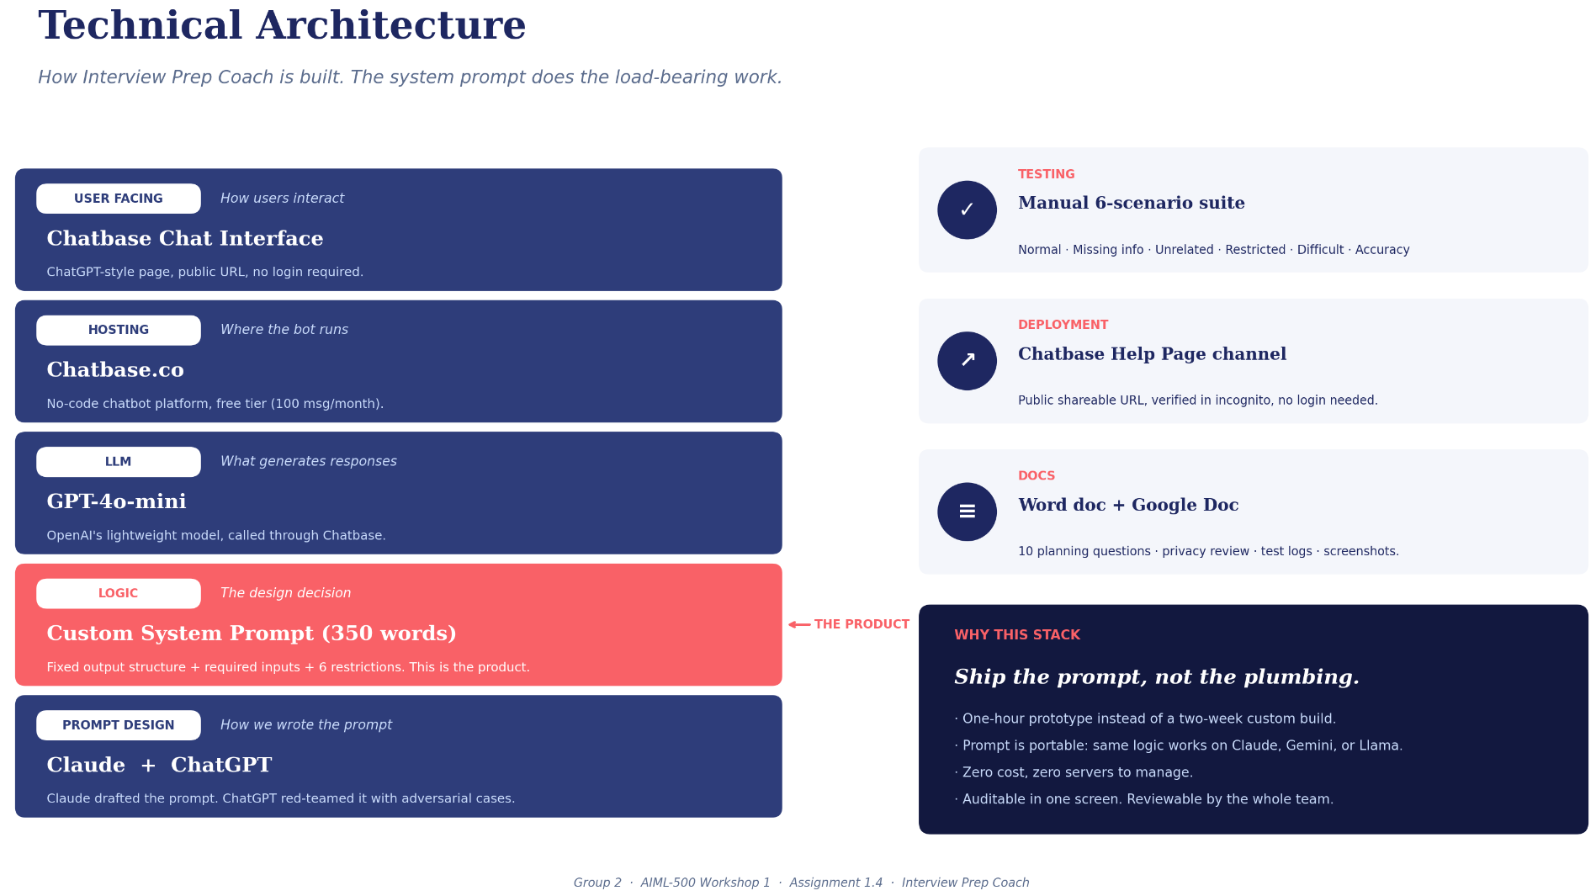
Notes:
[3:15 — Reflection slide] What design thinking taught us. Two things. First, the empathize stage saved us from over-engineering. Our first instinct was to scrape Glassdoor and build a huge database of real interview questions. Talking to classmates told us that quantity of questions was not the problem. The problem was structure and feedback. That let us skip a two-week engineering build and ship a bot that solves the real pain in one hour. Second, the prototype-test loop caught two prompt problems that would have made the bot useless. Version one gave scripted answers users could memorize, which is exactly what we didn't want. Version two had generic follow-up questions that could apply to any role. Iteration fixed both.

Slide 9
CLOSING
Limits and what's next
MAIN LIMITATION
NEXT VERSION
No source citations
Add a retrieval layer
If a candidate asks about a specific company's real interview process, the bot can't verify anything. It works from generic role patterns, not verified data.
Retrieval over public Glassdoor and Levels.fyi data. So the bot grounds its answers in real reported experiences instead of generic patterns.
SUBMISSION FOLDER
Public working link · 10 planning questions answered · Privacy and terms review · Every test scenario logged
Thanks for watching.
Notes:
[3:45 — Closing] Limits and what's next. The main limitation of the current version is that it doesn't cite sources. If a candidate asks about a specific company's real interview process, the bot can't verify anything. A future version would add a retrieval layer over public Glassdoor and Levels.fyi data, so the bot could ground its answers in real reported experiences. Our public working link is in the submission folder. The written documentation covers the ten planning questions, our privacy and terms review, and every test scenario. Thanks for watching.

